Slide 1
Abstract Trees

Slide 2
Outline
This topic discusses the concept of an abstract tree:
Hierarchical ordering
Description of an Abstract Tree
Applications
Implementation
Local definitions

Slide 3
Outline
4.2.1
A hierarchical ordering of a finite number of objects may be stored in a tree data structure
Operations on a hierarchically stored container include:
Accessing the root:
Given an object in the container:
Access the parent of the current object
Find the degree of the current object
Get a reference to a child,
Attach a new sub-tree to the current object
Detach this tree from its parent
Notes:
3

Slide 4
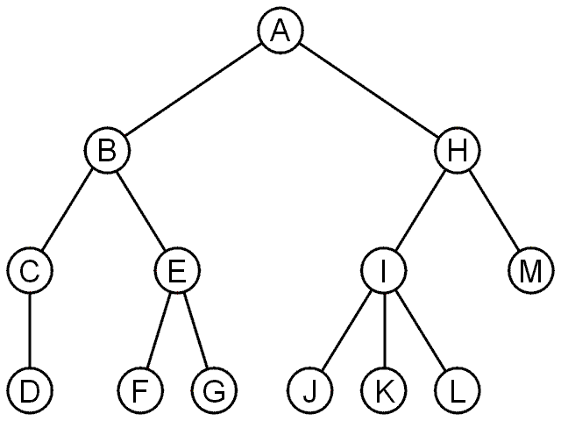
General Trees
4.2.1
An abstract tree does not restrict the number of nodes
In this tree, the degrees vary:
Degree | Nodes
0 | D, F, G, J, K, L, M
1 | C
2 | B, E, H
3 | I

Slide 5
General Trees: Design
4.2.2
We can implement a general tree by using a class which:
Stores an element
Stores the children in a linked-list

Slide 6
Implementation
4.2.2
The class definition would be:
template <typename Type>
class Simple_tree {
private:
Type element;
Simple_tree *parent_node;
ece250::Single_list<Simple_tree *> children;
public:
Simple_tree( Type const & = Type(), Simple_tree * = nullptr );
Type retrieve() const;
Simple_tree *parent() const;
int degree() const;
bool is_root() const;
bool is_leaf() const;
Simple_tree *child( int n ) const;
int height() const;
void insert( Type const & );
void attach( Simple_tree * );
void detach();
};

Slide 7
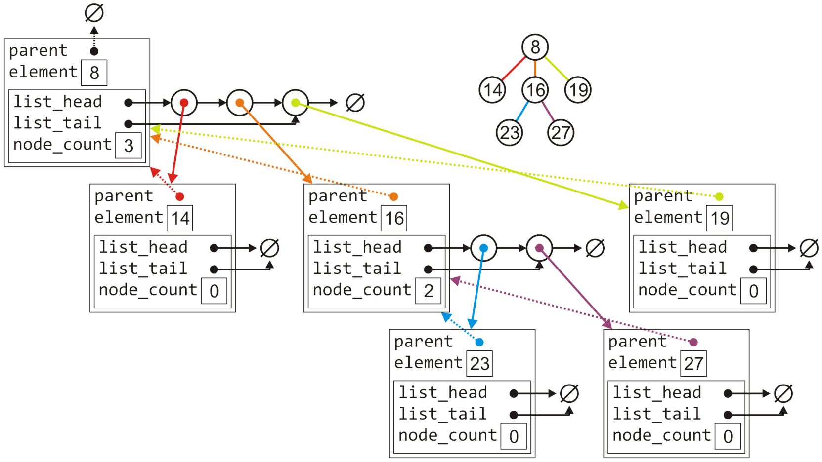
Implementation
4.2.2
The tree with six nodes would be stored as follows:

Slide 8
Implementation
4.2.2.1
Much of the functionality is similar to that of the Single_list class:
template <typename Type>
Simple_tree<Type>::Simple_tree( Type const &obj, Simple_tree *p ):
element( obj ),
parent_node( p ) {
// Empty constructor
}
template <typename Type>
Type Simple_tree<Type>::retrieve() const {
return element;
}
template <typename Type>
Simple_tree<Type> *Simple_tree<Type>::parent() const {
return parent_node;
}

Slide 9
Implementation
4.2.2.1
Much of the functionality is similar to that of the Single_list class:
template <typename Type>
bool Simple_tree<Type>::is_root() const {
return ( parent() == nullptr );
}
template <typename Type>
int Simple_tree<Type>::degree() const {
return children.size();
}
template <typename Type>
bool Simple_tree<Type>::is_leaf() const {
return ( degree() == 0 );
}

Slide 10
Implementation
4.2.2.2
Accessing the n^{th} child requires a for loop (Θ(n)):
template <typename Type>
Simple_tree<Type> *Simple_tree<Type>::child( int n ) const {
if ( n < 0 || n >= degree() ) {
return nullptr;
}
ece250::Single_node<Simple_tree *> *ptr = children.head();
for ( int i = 1; i < n; ++i ) {
ptr = ptr->next();
}
return ptr->retrieve();
}

Slide 11
Implementation
4.2.2.3
Attaching a new object to become a child is similar to a linked list:
template <typename Type>
void Simple_tree<Type>::attach( Type const &obj ) {
children.push_back( new Simple_tree( obj, this ) );
}

Slide 12
Implementation
4.2.2.3
To detach a tree from its parent:
If it is already a root, do nothing
Otherwise, erase this object from the parent’s list of children and set the parent pointer to zero
template <typename Type>
void Simple_tree<Type>::detach() {
if ( is_root() ) {
return;
}
parent()->children.erase( this );
parent_node = nullptr;
}

Slide 13
Implementation
4.2.2.3
Attaching an entirely new tree as a sub-tree, however, first requires us to check if the tree is not already a sub-tree of another node:
If so, we must detach it first and only then can we add it
template <typename Type>
void Simple_tree<Type>::attach( Simple_tree<Type> *tree ) {
if ( !tree->is_root() ) {
tree->detach();
}
tree->parent_node = this;
children.push_back( tree );
}

Slide 14
Implementation
4.2.2.4
Suppose we want to find the size of a tree:
If there are no children, the size is 1
Otherwise, the size is one plus the size of all the children
template <typename Type>
int Simple_tree<Type>::size() const {
int s = 1;
for (
ece250::Single_node<Simple_tree *> *ptr = children.head();
ptr != nullptr; ptr = ptr->next()
) {
s += ptr->retrieve()->size();
}
return s;
}

Slide 15
Implementation
4.2.2.4
Suppose we want to find the height of a tree:
If there are no children, the height is 0
Otherwise, the height is one plus the maximum height of any sub tree
#include <algorithm>
// ...
template <typename Type>
int Simple_tree<Type>::height() const {
int h = 0;
for (
ece250::Single_node<Simple_tree *> *ptr = children.head();
ptr != nullptr; ptr = ptr->next()
) {
h = std::max( h, 1 + ptr->retrieve()->height() );
}
return h;
}

Slide 16
Implementation
4.2.3
Implementing a tree by storing the children in an array is similar, however, we must deal with the full structure
A general tree using an array would have a constructor similar to:
template <typename Type>
Simple_tree<Type>::Simple_tree( Type const &obj, Simple_tree *p ):
element( obj ),
parent_node( p ),
child_count( 0 ),
child_capacity( 4 ),
children( new Simple_tree *[child_capacity] ) {
// Empty constructor
}

Slide 17
Locally Defined Orders
4.2.4
In many, hierarchical orders are described locally:
One object is defined to be a descendant of another
In Java, subclasses are given in the class definitions:
public class Matrix { // implicitly extends Object
// ...
}
public class SymmetricMatrix extends Matrix {
// ...
}
The parent is said to be the superclass, children are subclasses
The Object class is the root

Slide 18
Locally Defined Orders
4.2.4
A directory structure is dynamically constructed through local definitions:
{eceunix:1} mkdir ece250
The parent is usually referred to as the parent directory
Given the generic name ..
E.g., cd ..
Children are referred to as subdirectories
In Unix, there is a single root /
In Microsoft Windows, each drive has a root, e.g., C:\
The collection of all drives can be referred to as a forest

Slide 19
Summary
In this topic, we have looked at one implementation of a general tree:
store the value of each node
store all the children in a linked list
not an easy (Θ(1)) way to access children
if we use an array, different problems...

Slide 20
References
[1] Donald E. Knuth, The Art of Computer Programming, Volume 1: Fundamental Algorithms, 3rd Ed., Addison Wesley, 1997, §2.2.1, p.238.

Slide 21
Usage Notes
These slides are made publicly available on the web for anyone to use
If you choose to use them, or a part thereof, for a course at another institution, I ask only three things:
that you inform me that you are using the slides,
that you acknowledge my work, and
that you alert me of any mistakes which I made or changes which you make, and allow me the option of incorporating such changes (with an acknowledgment) in my set of slides
Sincerely,
Douglas Wilhelm Harder, MMath
dwharder@alumni.uwaterloo.ca

